Slide 1
Analytical method validation

Slide 2
General Principles of analytical method validation
HPLC
Dissolution apparatus
UV/Visible spectrophotometers

Slide 3
LIST OF CONTENTS
OBJECTIVE
PUBLISHED GUIDANCES
TYPES OF ANALYTICAL METHOD TO BE VALIDATED
CONSIDERATIONS PRIOR TO METHOD VALIDATION
TYPICAL ANALYTICAL PERFORMANCE
CHARACTERISTICS USED IN METHOD VALIDATION
REVALIDATION
POSSIBLE QUESTIONS
REFERENCES

Slide 4
PUBLISHED GUIDANCES
ICH-Q2A “Text on Validation of Analytical Procedure:(1994)
ICH-Q2B “Validation of Analytical Procedures: Methodology: (1995)
CDER “Reviewer Guidance: Validation of Chromatographic Method” (1994)
CDER “Submitting Samples and Analytical Data for Method Validations” (1987)
CDER Draft “Analytical Procedures and Method Validation” (2000)
CDER “Bioanalytical Method Validation for Human Studies” (1999)
USP<1225> “Validation of Compendial Methods” (current revision)

Slide 5

QC
Part of
Verifying system suitability
WHY ANALYTICAL METHOD VALIDATION
registration
application
For submission to Compendia
Notes:
EC, Japan and USA.

Slide 6
SUBMISSION TO THE COMPENDIA
RATIONALE
PROPOSED ANALYTICAL PROCEDURE
DATA ELEMENTS

Slide 7
TYPES OF ANALYTICAL PROCEDURES TO BE VALIDATED
Identification tests.
Quantitative tests for impurities’ content.
Limit tests for the control of impurities.
Quantitative tests of the active moiety in samples of drug.
substance or drug product or other selected component(s) in the drug product.

Slide 8
Identification tests
Identification tests are intended to ensure the identity of an analyte in a sample. This is normally achieved by comparison of a property of the sample (e.g., spectrum, chromatographic behavior, chemical reactivity, etc) to that of a reference standard;

Slide 9
Testing for impurities
Testing for impurities can be either a quantitative test or a limit test for the impurity in a sample. Either test is intended to accurately reflect the purity characteristics of the sample. Different validation characteristics are required for a quantitative test than for a limit test;

Slide 10
Assay procedures
Assay procedures are intended to measure the analyte present in a given sample.
The assay represents a quantitative measurement of the major component(s) in the drug substance.
For the drug product, similar validation characteristics also apply when assaying for the active or other selected component(s).
The same validation characteristics may also apply to assays associated with other analytical procedures (e.g., dissolution).
Notes:
robustness is not listed in the table but should be considered at an appropriate stage in the development of the analytical procedure.

Slide 11
revalidation may be necessary in the following circumstances
changes in the synthesis of the drug substance;
changes in the composition of the finished product;
changes in the analytical procedure.
Notes:
The degree of revalidation required depends on the nature of the changes.

Slide 12
CONSIDERATIONS PRIOR TO METHOD VALIDATION
Suitability of Instrument
Status of Qualification and Calibration
Suitability of Materials
Status of Reference Standards, Reagents, etc.
Suitability of Analyst
Status of Training and Qualification Records
Suitability of Documentation
Written analytical procedure and proper approved protocol with pre-established acceptance criteria.

Slide 13
EXAMPLES OF METHODS THAT REQUIRE VALIDATION DOCUMENTATION
CHROMATOGRAPHIC METHODS
SPECTROPHOTOMETRIC METHODS
CAPILLARY ELECTROPHORESIS METHODS
PARTICLE SIZE ANALYSIS METHODS
DISSOLUTION METHODS
TITRATION METHODS
AUTOMATED ANALYTICAL METHODS

Slide 14
ANALYTICAL METHOD VALIDATION
Validation of an analytical method is the process by which it is established, by laboratory studies, that the performance characteristics of the method meet the requirements for the intended analytical applications.

Slide 15
TYPICAL ANALYTICAL PERFORMANCE CHARACTERISTICS USED IN METHOD VALIDATION
Specificity (Selectivity)
Linearity
Range
Accuracy
Precision
Detection Limit
Quantitation Limit
Robustness
System Suitability Testing

Slide 16
SPECIFICITY
SPECIFICITY is the ability to assess unequivocally the analyte in presence of components which may be expected to be present.
Typically these might include impurities, degradants, matrix, etc.
DETERMINATION
IDENTIFICATION TESTS
ASSAY AND IMPURITY TEST(S)
Impurities are available
Impurities are not available
Notes:
It is not always possible to demonstrate that an analytical procedure is specific for a particular analyte (complete discrimination). In this case a combination of two or more analytical procedures is recommended to achieve the necessary level of discrimination.

Slide 17
Identification: to ensure the identity of an analyte.
Purity Tests: to ensure that all the analytical procedures performed allow an accurate statement of the content of impurities of an analyte, i.e. related substances test, heavy metals, residual solvents content, etc.
Assay (content or potency): to provide an exact result which allows an accurate statement on the content or potency of the analyte in a sample.

Slide 18
Identification
Suitable identification tests should be able to discriminate between compounds of closely related structures which are likely to be present. The discrimination of a procedure may be confirmed by obtaining positive results (perhaps by comparison with a known reference material) from samples containing the analyte, coupled with negative results from samples which do not contain the analyte. In addition, the identification test may be applied to materials structurally similar to or closely related to the analyte to confirm that a positive response is not obtained. The choice of such potentially interfering materials should be based on sound scientific judgement with a consideration of the interferences that could occur.

Slide 19
Assay and Impurity Test(s)
For chromatographic procedures, representative chromatograms should be used to demonstrate specificity and individual components should be appropriately labelled.
Critical separations in chromatography should be investigated at an appropriate level. For critical separations, specificity can be demonstrated by the resolution of the two components which elute closest to each other.
In cases where a non-specific assay is used, other supporting analytical procedures should be used to demonstrate overall specificity. For example, where a titration is adopted to assay the drug substance for release, the combination of the assay and a suitable test for impurities can be used.

Slide 20
The approach is similar for both assay and impurity tests:
Impurities are available
For the assay , this should involve demonstration of the discrimination of the analyte in the presence of impurities and/or excipients; practically, this can be done by spiking pure substances (drug substance or drug product) with appropriate levels of impurities and/or excipients and demonstrating that the assay result is unaffected by the presence of these materials (by comparison with the assay result obtained on unspiked samples).
For the impurity test, the discrimination may be established by spiking drug substance or drug product with appropriate levels of impurities and demonstrating the separation of these impurities individually and/or from other components in the sample matrix.

Slide 21
If impurity or degradation product standards are unavailable, specificity may be demonstrated by comparing the test results of samples containing impurities or degradation products to a second well-characterized procedure e.g.: pharmacopoeial method or other validated analytical procedure (independent procedure). As appropriate, this should include samples stored under relevant stress conditions: light, heat, humidity, acid/base hydrolysis and oxidation.
- for the assay, the two results should be compared;
- for the impurity tests, the impurity profiles should be compared.
Peak purity tests may be useful to show that the analyte chromatographic peak is not attributable to more than one component (e.g., diode array, mass spectrometry).

Slide 22
LINEARITY
LINEARITY of an analytical procedure is its ability (within a given range) to obtain test results which are directly proportional to the concentration (amount) of analyte in the sample.
DETERMINATION- Linearity should be evaluated by visual inspection of a plot of signals as a function of analyte concentration or content.
For the establishment of linearity, a minimum of five concentrations is recommended.
NOTE

Slide 23
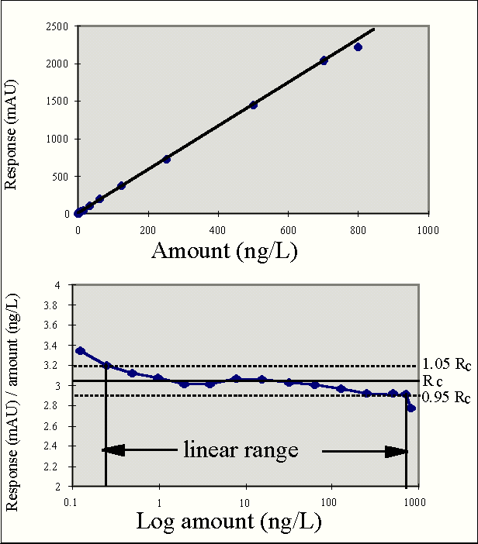

Slide 24
A linear relationship should be evaluated across the range of the analytical procedure.
It may be demonstrated directly on the drug substance (by dilution of a standard stock solution) and/or separate weighings of synthetic mixtures of the drug product components, using the proposed procedure. The latter aspect can be studied during investigation of the range.

Slide 25
If there is a linear relationship, test results should be evaluated by appropriate statistical methods, for example, by calculation of a regression line by the method of least squares. In some cases, to obtain linearity between assays and sample concentrations, the test data may need to be subjected to a mathematical transformation prior to the regression analysis. Data from the regression line itself may be helpful to provide mathematical estimates of the degree of linearity.
The correlation coefficient, y-intercept, slope of the regression line and residual sum of squares should be submitted. A plot of the data should be included. In addition, an analysis of the deviation of the actual data points from the regression line may also be helpful for evaluating linearity.
Some analytical procedures, such as immunoassays, do not demonstrate linearity after any transformation. In this case, the analytical response should be described by an appropriate function of the concentration (amount) of an analyte in a sample.

Slide 26
RANGE
RANGE of an analytical procedure is the interval between the upper and lower concentration (amounts) of analyte in the sample (including these concentrations) for which it has been demonstrated that the analytical procedure has a suitable level of precision, accuracy and linearity.
DETERMINATION-The specified range is normally derived from linearity studies and depends on the intended application of the procedure.

Slide 27
It is established by confirming that the analytical procedure provides an acceptable degree of linearity, accuracy and precision when applied to samples containing amounts of analyte within or at the extremes of the specified range of the analytical procedure.
The following minimum specified ranges should be considered:
- for the assay of a drug substance or a finished (drug) product: normally from 80 to 120 percent of the test concentration;
- for content uniformity, covering a minimum of 70 to 130 percent of the test concentration, unless a wider more appropriate range, based on the nature of the dosage form (e.g., metered dose inhalers), is justified;
- for dissolution testing: +/-20 % over the specified range;
e.g., if the specifications for a controlled released product cover a region from 20%, after 1 hour, up to 90%, after 24 hours, the validated range would be 0-110% of the label claim.

Slide 28
for the determination of an impurity: from the reporting level of an impurity1 to 120% of the specification;
- for impurities known to be unusually potent or to produce toxic or unexpected pharmacological effects, the detection/quantitation limit should be commensurate with the level at which the impurities must be controlled;
Note: for validation of impurity test procedures carried out during development, it may be necessary to consider the range around a suggested (probable) limit.
- if assay and purity are performed together as one test and only a 100% standard is used, linearity should cover the range from the reporting level of the impurities1 to 120% of the assay specification.

Slide 29
ACCURACY
ACCURACY of an analytical method is the closeness of test
results obtained by that method to the true value.
DETERMINATION-Accuracy should be established across
the specified range of the analytical procedure.
ASSAY
Drug Substance
Drug Product
IMPURITIES (QUANTITATION)
Accuracy should be assessed using a minimum of 9 determinations over a minimum of 3 concentration levels covering the specified range (i.e., three concentrations and three replicates of each).
NOTE
Notes:
The accuracy of an analytical procedure expresses the closeness of agreement between the value which is accepted either as a conventional true value or an accepted reference value and the value found.

Slide 30
Accuracy should be established across the specified range of the analytical procedure.
Assay
Drug Substance
Several methods of determining accuracy are available:
a) application of an analytical procedure to an analyte of known purity (e.g. reference material);
b) comparison of the results of the proposed analytical procedure with those of a second well-characterized procedure, the accuracy of which is stated and/or defined (independent procedure, see 1.2.);
c) accuracy may be inferred once precision, linearity and specificity have been established.

Slide 31
Drug Product
Several methods for determining accuracy are available:
a) application of the analytical procedure to synthetic mixtures of the drug product components to which known quantities of the drug substance to be analysed have been added;
b) in cases where it is impossible to obtain samples of all drug product components , it may be acceptable either to add known quantities of the analyte to the drug product or to compare the results obtained from a second, well characterized procedure, the accuracy of which is stated and/or defined (independent procedure, see 1.2.);
c) accuracy may be inferred once precision, linearity and specificity have been established.

Slide 32
Impurities (Quantitation)
Accuracy should be assessed on samples (drug substance/drug product) spiked with known amounts of impurities.
In cases where it is impossible to obtain samples of certain impurities and/or degradation products, it is considered acceptable to compare results obtained by an independent procedure . The response factor of the drug substance can be used.
It should be clear how the individual or total impurities are to be determined e.g., weight/weight or area percent, in all cases with respect to the major analyte.

Slide 33
Accuracy should be reported as percent recovery by the assay of known added amount of analyte in the sample or as the difference between the mean and the accepted true value together with the confidence intervals.

Slide 34
PRECISION
PRECISION of an analytical method is the degree of agreement among
individual test results when the method is applied repeatedly to multiple
samplings of a homogenous sample under the prescribed conditions.
DETERMINATION- A sufficient number of aliquots of a
homogeneous sample are assayed to be able to calculate statistically valid
estimates of standard deviation , variance, coefficient of variation or relative standard deviation of a series of measurements. .
Repeatability
Intermediate precision
Reproducibilty
Notes:
Precision should be investigated using homogeneous, authentic samples. However, if it is not possible to obtain a homogeneous sample it may be investigated using artificially prepared samples or a sample solution.

Slide 35
Validation of tests for assay and for quantitative determination of impurities includes an investigation of precision.

Slide 36
Repeatability
Repeatability expresses the precision under the same operating conditions over a short interval of time. Repeatability is also termed intra-assay precision .
a) a minimum of 9 determinations covering the specified range for the procedure (e.g., 3 concentrations/3 replicates each);
or
b) a minimum of 6 determinations at 100% of the test concentration.

Slide 37
Intermediate precision
Intermediate precision expresses within-laboratories variations: different days, different analysts, different equipment, etc.
The extent to which intermediate precision should be established depends on the circumstances under which the procedure is intended to be used. The applicant should establish the effects of random events on the precision of the analytical procedure. Typical variations to be studied include days, analysts, equipment, etc. It is not considered necessary to study these effects individually. The use of an experimental design (matrix) is encouraged.

Slide 38
Reproducibility
Reproducibility expresses the precision between laboratories (collaborative studies, usually applied to standardization of methodology).
Reproducibility is assessed by means of an inter-laboratory trial. Reproducibility should be considered in case of the standardization of an analytical procedure, for instance, for inclusion of procedures in pharmacopoeias. These data are not part of the marketing authorization dossier.
The standard deviation, relative standard deviation (coefficient of variation) and confidence interval should be reported for each type of precision investigated.

Slide 39
DETECTION LIMIT
DETECTION LIMIT of an individual analytical procedure is the lowest amount of analyte in a sample which can be detected but not necessarily quantitated, under the stated experimental conditions.
DETERMINATION- Several approaches for determining the detection limit are possible, depending on whether the procedure is a non-instrumental or instrumental.
BASED ON VISUAL EXAMINATION
BASED ON SIGNAL TO NOISE RATIO

Slide 40
Based on Visual Evaluation
Visual evaluation may be used for non-instrumental methods but may also be used with instrumental methods.
The detection limit is determined by the analysis of samples with known concentrations of analyte and by establishing the minimum level at which the analyte can be reliably detected.

Slide 41
Based on Signal-to-Noise
This approach can only be applied to analytical procedures which exhibit baseline noise.
Determination of the signal-to-noise ratio is performed by comparing measured signals from samples with known low concentrations of analyte with those of blank samples and establishing the minimum concentration at which the analyte can be reliably detected. A signal-to-noise ratio between 3 or 2:1 is generally considered acceptable for estimating the detection limit.

Slide 42
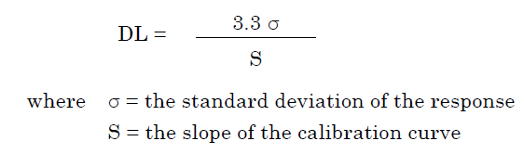
Based on the Standard Deviation of the Response and the Slope
The detection limit (DL) may be expressed as:
The slope S may be estimated from the calibration curve of the analyte. The estimate of σ may be carried out in a variety of ways, for example:

Slide 43
Based on the Standard Deviation of the Blank
Measurement of the magnitude of analytical background response is performed by analyzing an appropriate number of blank samples and calculating the standard deviation of these responses.
Based on the Calibration Curve
A specific calibration curve should be studied using samples containing an analyte in the range of DL. The residual standard deviation of a regression line or the standard deviation of y-intercepts of regression lines may be used as the standard deviation.

Slide 44
The detection limit and the method used for determining the detection limit should be presented. If DL is determined based on visual evaluation or based on signal to noise ratio, the presentation of the relevant chromatograms is considered acceptable for justification.
In cases where an estimated value for the detection limit is obtained by calculation or extrapolation, this estimate may subsequently be validated by the independent analysis of a suitable number of samples known to be near or prepared at the detection limit.

Slide 45
QUANTITATION LIMIT
QUANTITATION LIMIT of an individual analytical procedure is the lowest amount of analyte in a sample which can be quantitatively determined with suitable precision and accuracy.
The quantitation limit is a parameter of quantitative assays for low levels of compounds in sample matrices, and is used particularly for the determination of impurities and/or degradation products.
DETERMINATION- Several approaches for determining the detection limit are possible, depending on whether the procedure is a non-instrumental or instrumental.
BASED ON VISUAL EXAMINATION
BASED ON SIGNAL TO NOISE RATIO

Slide 46
LOQ, LOD and SNR Limit of Quantitation Limit of Detection Signal to Noise Ratio
Peak B LOQ
Peak A LOD
Baseline
noise

Slide 47
Based on Visual Evaluation
Visual evaluation may be used for non-instrumental methods but may also be used with instrumental methods.
The quantitation limit is generally determined by the analysis of samples with known concentrations of analyte and by establishing the minimum level at which the analyte can be quantified with acceptable accuracy and precision.

Slide 48
Based on Signal-to-Noise Approach
This approach can only be applied to analytical procedures that exhibit baseline noise.
Determination of the signal-to-noise ratio is performed by comparing measured signals from samples with known low concentrations of analyte with those of blank samples and by establishing the minimum concentration at which the analyte can be reliably quantified. A typical signal-to-noise ratio is 10:1.

Slide 49
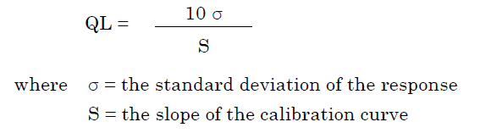
Based on the Standard Deviation of the Response and the Slope
The quantitation limit (QL) may be expressed as:

Slide 50
The slope S may be estimated from the calibration curve of the analyte. The estimate of σ may be carried out in a variety of ways for example:
Based on Standard Deviation of the Blank
Measurement of the magnitude of analytical background response is performed by analyzing an appropriate number of blank samples and calculating the standard deviation of these responses.
Based on the Calibration Curve
A specific calibration curve should be studied using samples, containing an analyte in the range of QL. The residual standard deviation of a regression line or the standard deviation of y-intercepts of regression lines may be used as the standard deviation.
Notes:
The quantitation limit and the method used for determining the quantitation limit should be presented.
The limit should be subsequently validated by the analysis of a suitable number of samples known to be near or prepared at the quantitation limit.

Slide 51
RUGGEDNESS
RUGGEDNESS of an analytical method is the degree of reproducibility of test results obtained by the analysis of the same samples under a variety of conditions, such as different laboratories different analyst, different instruments, different lots of reagent, different elapsed assay times, different assay temperatures, different days, etc.
Included in
NOTE
but not in

Slide 52
ROBUSTNESS
ROBUSTNESS of an analytical procedure is a measure of its capacity to remain unaffected by small, but deliberate variations in method parameters and provides an indication of its reliability during normal usage.
DETERMINATION- The evaluation of robustness should be considered during the development phase and depends on the type of procedure under study.

Slide 53
If measurements are susceptible to variations in analytical conditions, the analytical conditions should be suitably controlled or a precautionary statement should be included in the procedure. One consequence of the evaluation of robustness should be that a series of system suitability parameters (e.g., resolution test) is established to ensure that the validity of the analytical procedure is maintained whenever used.
Examples of typical variations are:
- stability of analytical solutions;
- extraction time.
In the case of liquid chromatography, examples of typical variations are:
- influence of variations of pH in a mobile phase;
- influence of variations in mobile phase composition;
- different columns (different lots and/or suppliers);
- temperature;
- flow rate.
In the case of gas-chromatography, examples of typical variations are:
- different columns (different lots and/or suppliers);
- temperature;
- flow rate.

Slide 54
SYSTEM SUITABILITY TESTING
SYSTEM SUITABILITY TESTING is an integral part of many analytical procedures. The tests are based on the concept that the equipment, electronics, analytical operations and samples to be analyzed constitute an integral system that can be evaluated as such.
System suitability test parameters to be established for a particular procedure depend on the type of procedure being validated.

Slide 55
Chromatograph the standard preparation, adjusting the operating parameters so that the retention time of the nitrofurantoin peak is about 8 min and the peak heights are about half full-scale.
The resolution, R, between acetanilide and nitrofurantoin is not less than 3.0, and the relative standard deviation determined from the ratio of the peak responses in replicate injections is not more than 2.0%.

Slide 56
Retention
Resolution
LOD, LLOQ and S/N
Plate Number
Peak Tailing
Precision
Accuracy
Pressure
Blanks
Priming Injections
Use of Quality Control Samples

Slide 57
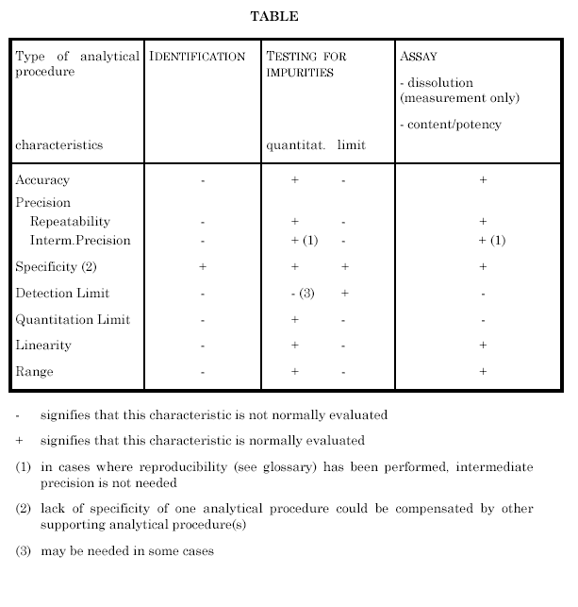
Recommended Validation Characteristics of the Various Types of Tests

Slide 58
REVALIDATION MAY BE NECESSARY IN THE FOLLOWING CIRCUMSTANCES:
changes in the synthesis of the drug substance;
changes in the composition of the finished
product;
changes in the analytical procedure;
The degree of revalidation required depends on
the nature of the changes. Certain other changes
may require validation as well.

Slide 59
POSSIBLE
QUESTIONS
Enlist published guidances pertaining to analytical method validation. (2 marks)
Why to go for analytical method validation? (2 marks)
Enlist typical analytical performance characteristics used in method validation. (2 marks)
Explain any four analytical performance characteristics in detail. (10 marks)
When is revalidation necessary? (2 marks)

Slide 60
REFERENCES
The United State Pharmacopoeia 24; The National
Formulary 19; 2000: [1225] VALIDATION OF
COMPENDIAL METHODS.
http://www.labcompliance.com/methods/meth_val.
htm#introduction
http://www.fda.gov/cder/guidance/2396dft.htm
www.fda.gov/ohrms/dockets/
ac/02/slides/3841s1_07_lachman.PPT
http://www.fda.gov/cder/guidance/ameth.htm

Slide 61
http://www.ich.org
http://www.fda.gov/cder/guidance/425
2fnl.htm
http://www.pharmtech.com/pharmtech/dat
a/articlestandard/pharmtech/102003/483
14/article.pdf
http://www.ivstandards.com/tech/reliabilit
y/part17.asp
http://www.aoac.org/

Slide 62
General Principles of analytical method validation

